Slide 1
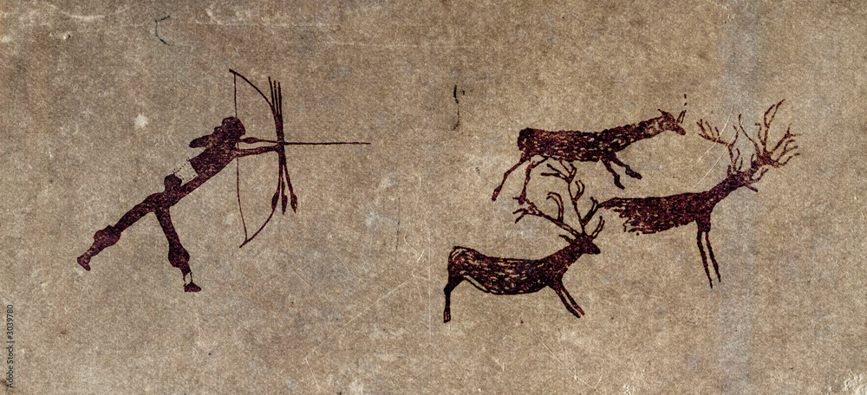
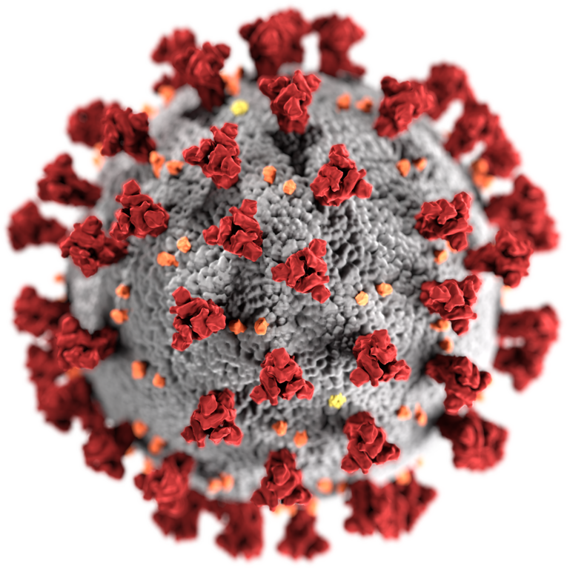
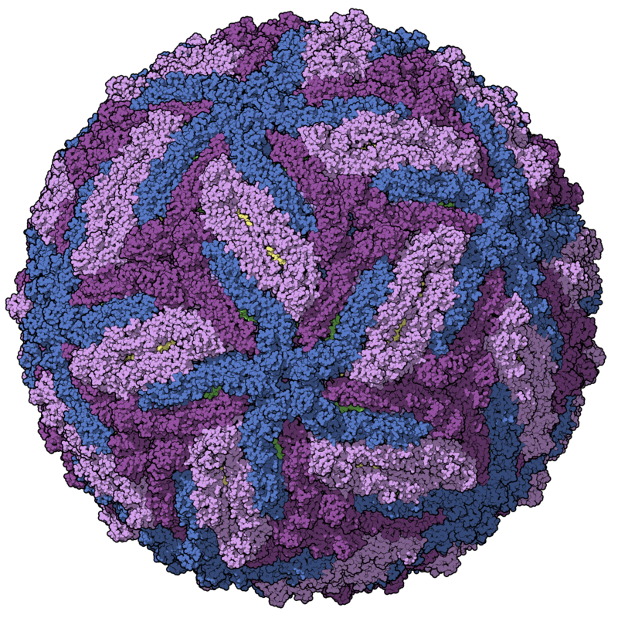
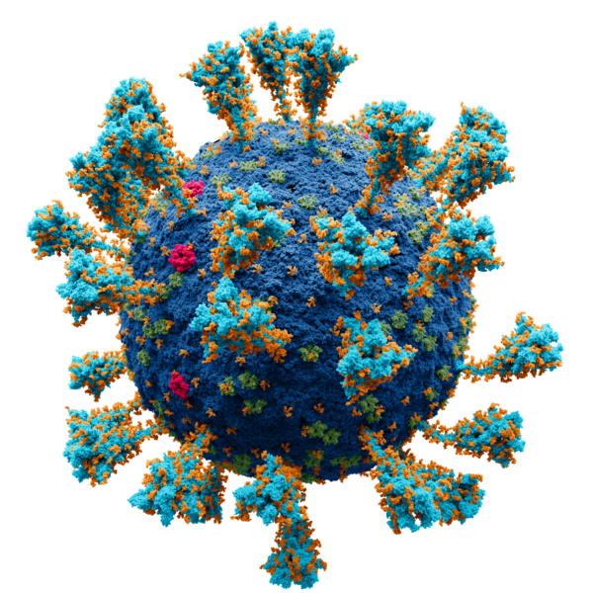
Characterization of the virome after liver
transplantation
VirushunterGatherer and Virusparies
Sergej Ruff
Twincore - RG Computational Virology
22 August 2024
Notes:
→ Good Morning
→ Today, Presenting the current progress of my master thesis, which I started almost 2 months ago.
→ Topic is the characterization of the virome after liver transplantation
→The Taubert Working Group at the MHH were so kind to provide me with liver Sequencing data
→ and I am applying VirushunterGatherer to characterize the virome of those samples and maybe find novel viruses.
→ Then I am plotting and analysing the output using a small R package I created called Virusparies.

Slide 2
Characterzation of the virome,VirusHunterGatherer and Virusparies - Outline
Material used
Taubert Data
Mammal Data
Results
SRA Data
Taubert
Virusparies Package
4. Concluson and Outlook
Notes:
The outline of the presentation
Follows the classic Paper/ Journal Structure.
First → Talk about the motivation behind virus discovery.
Second → Then I want to talk about the history of viral discovery real quick and how it applyes to vhvg.
Method → Talk about the data and changes made to VhVg. Present the output of VhVg that I used for further analysis.
Results
Conclusion and Outlook.

Slide 3
Taubert Data
Local files from AG Taubert
Notes:
→ Start with Intro.
→ (click): Why do we need Virus discovery
→ An obvious Reason is the discovery of disease causing viruses → Especially Pandemic causing once (click)

Slide 4
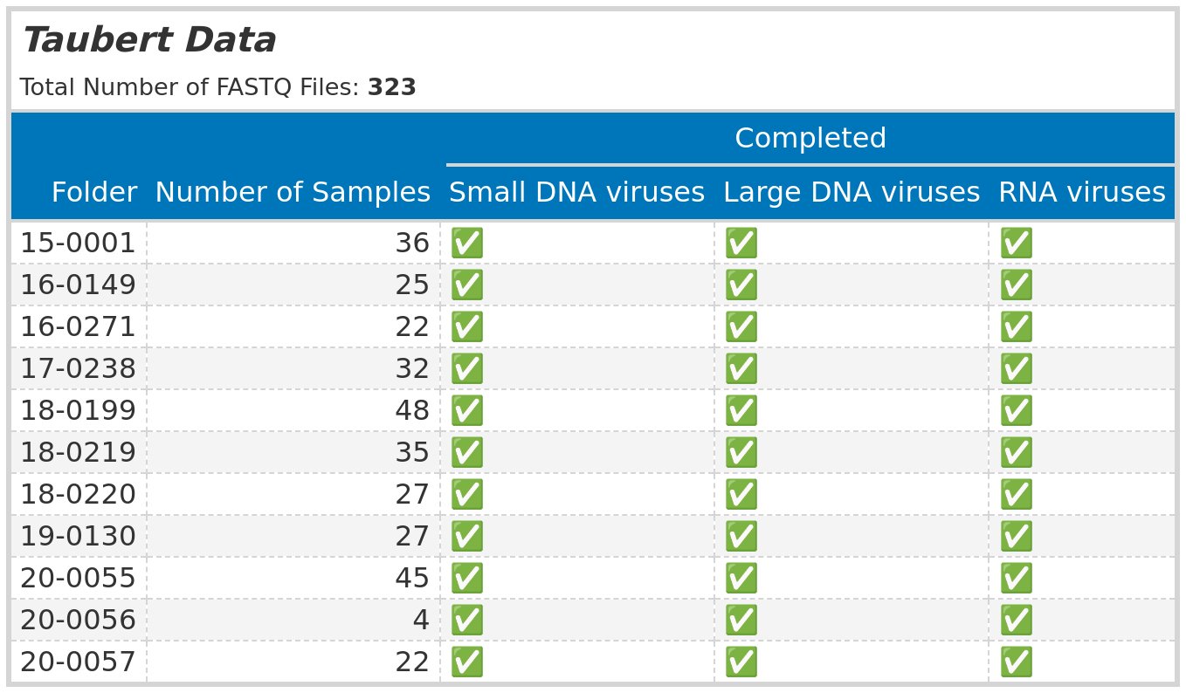
Material used: Taubert Data
Notes:
And there is a need for Tools and methods for quick and efficient virus discovery.
Plot of the major pandemic caused by viruses since 1900.
Spanish Flu caused by Influenza A virus h1n1 → 1918
Asian Flu pandemic caused by Influenza A virus H2n2 → 1957
Hong Kong Flu H3N2 → 1968
HIV → 1981
BUT (Click) The frequency of pandemics increased drasticly (Quote)
enchanced globilazation air travel ncreasing population entering animal habitats.
Need for Tools that can help identify potential pandemic causing viruses.
History of virus: Do I find an virus I find in humans in other animals.

Slide 5
Mammal Data
SRA IDs re-examined from existing Hittable
Notes:
→ Start with Intro.
→ (click): Why do we need Virus discovery
→ An obvious Reason is the discovery of disease causing viruses → Especially Pandemic causing once (click)

Slide 6
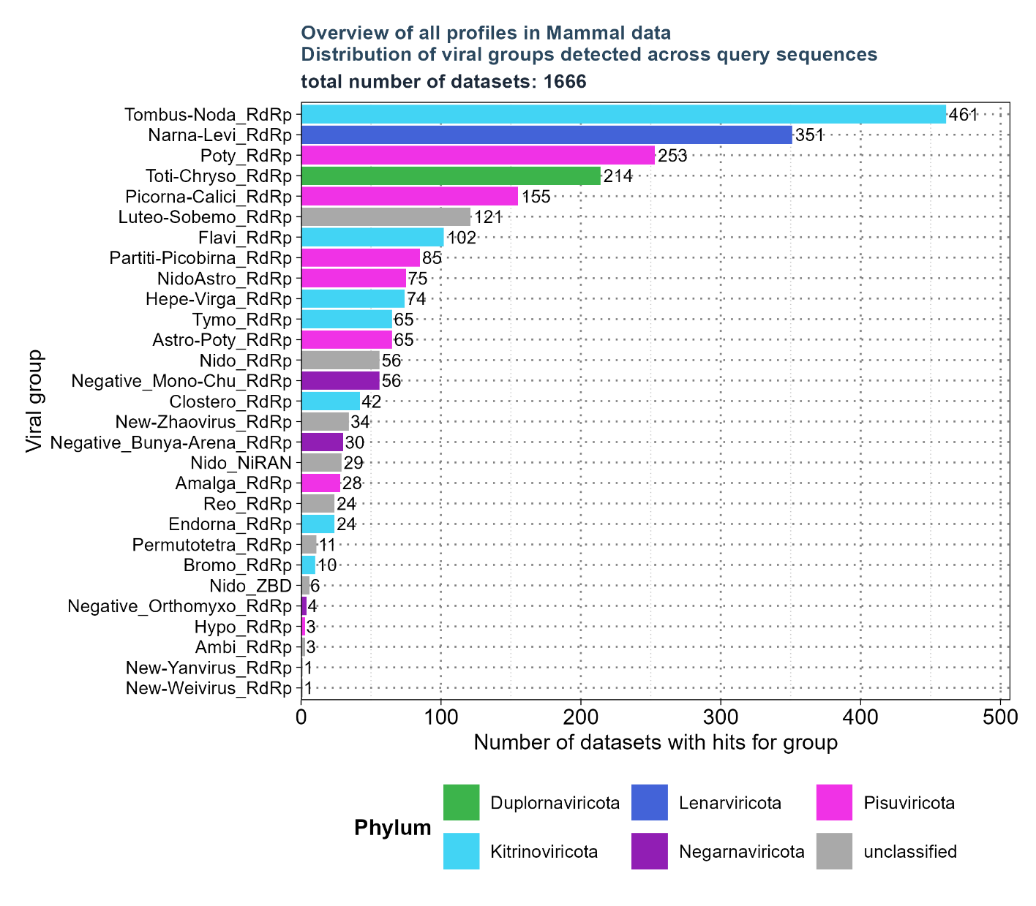
Material used: Mammal Data – overview of existing hittable.
Selected profiles:
Flavi_RdRp
Hepe-Virga_RdRp
Nido_RdRp
Negative_Bunya-Arena_RdRp
Negative_Mono-Chu_RdRp
Negative_Orthomyxo_RdRp
Nido_NiRAN
NidoAstro_RdRp
Existing Hittable:
34.337 unique SRA Ids
Filtered based on:
'num_hits' > 4
'ViralRefSeq_E' < 1e-5
'ViralRefSeq_ident' < 90

Slide 7
Results: Taubert

Slide 8
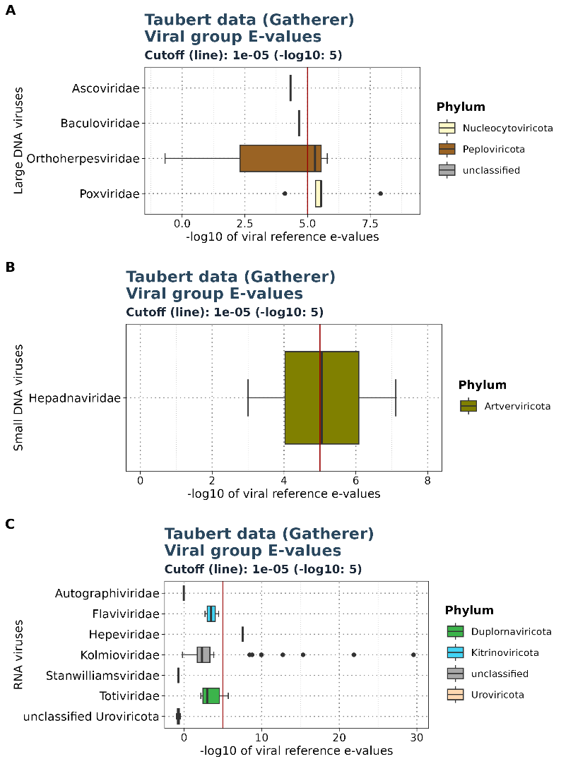
Results: Taubert - E-values
Showing only Gatherer results
Viral reference E-values for each group

Slide 9
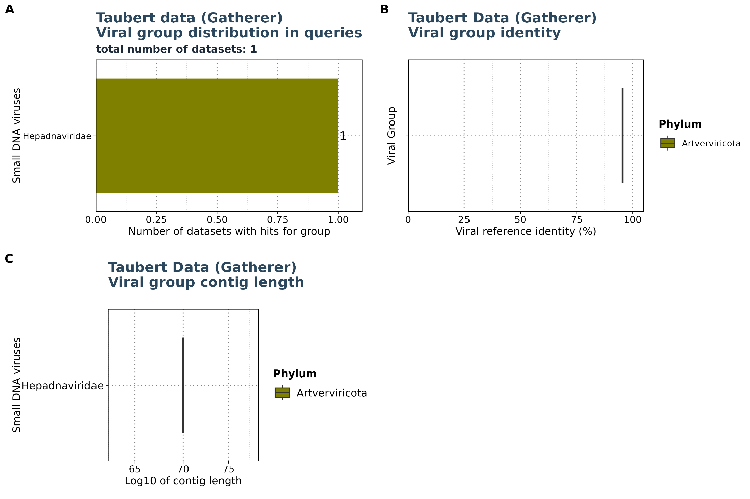
Results: Taubert
Small DNA viruses

Slide 10
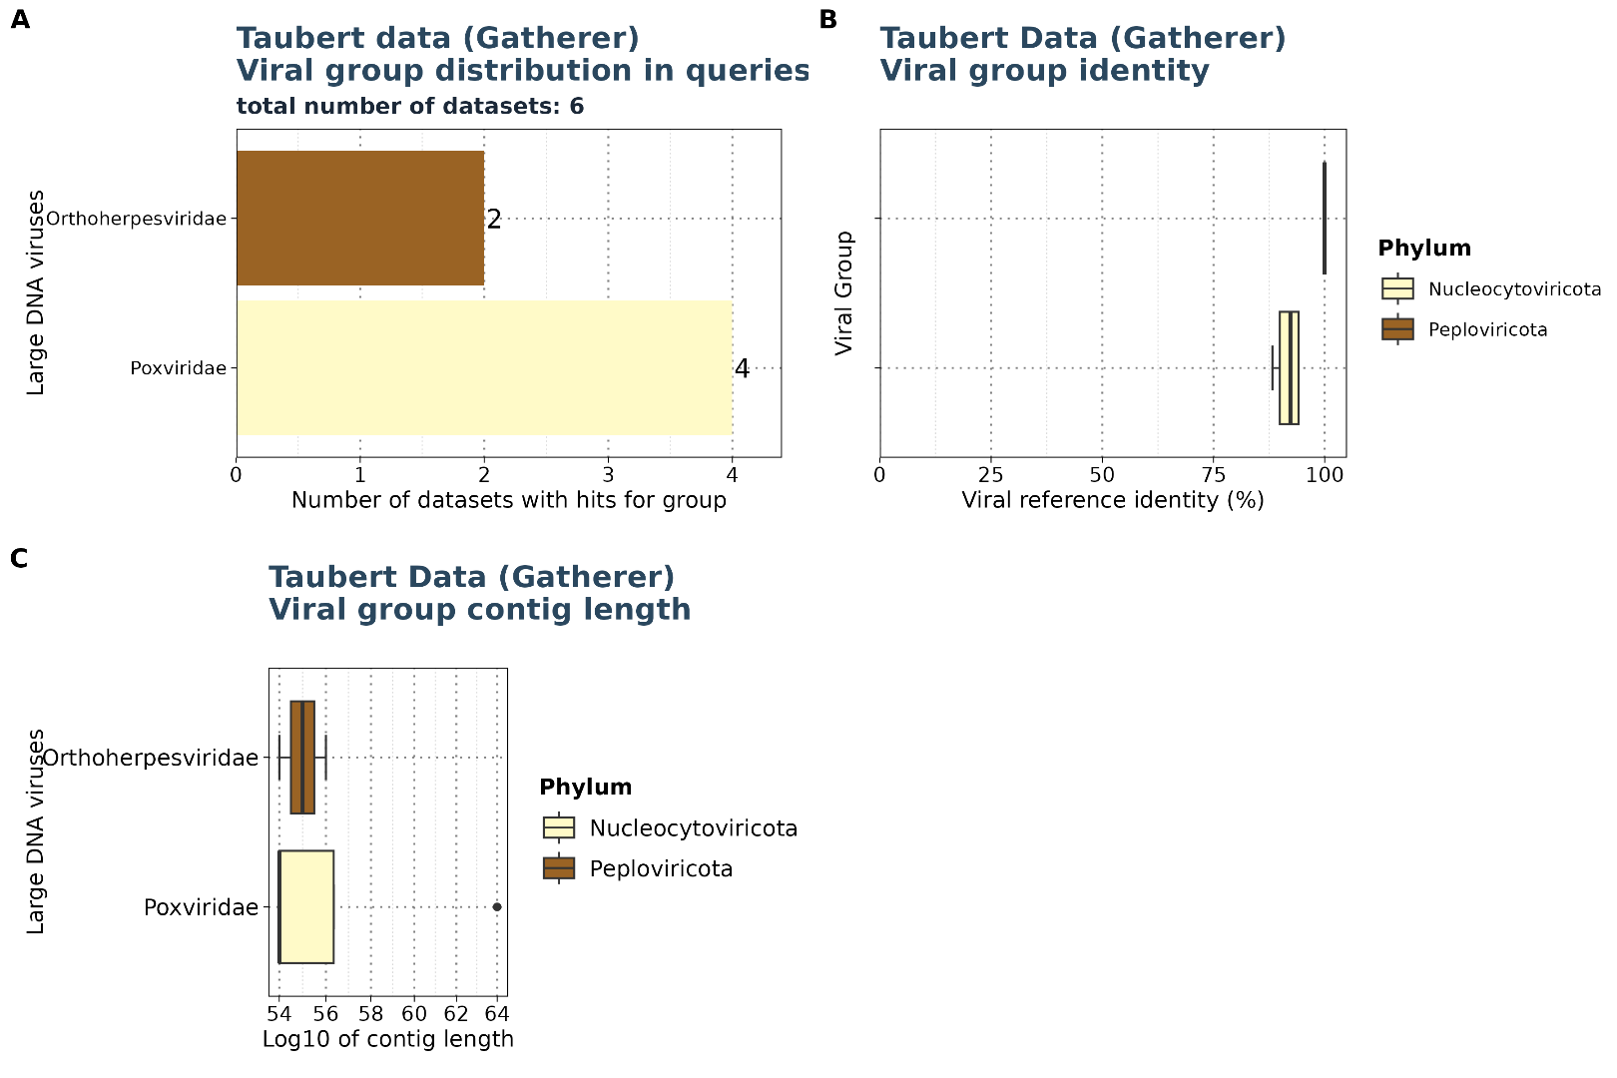
Results: Taubert
Large DNA viruses

Slide 11
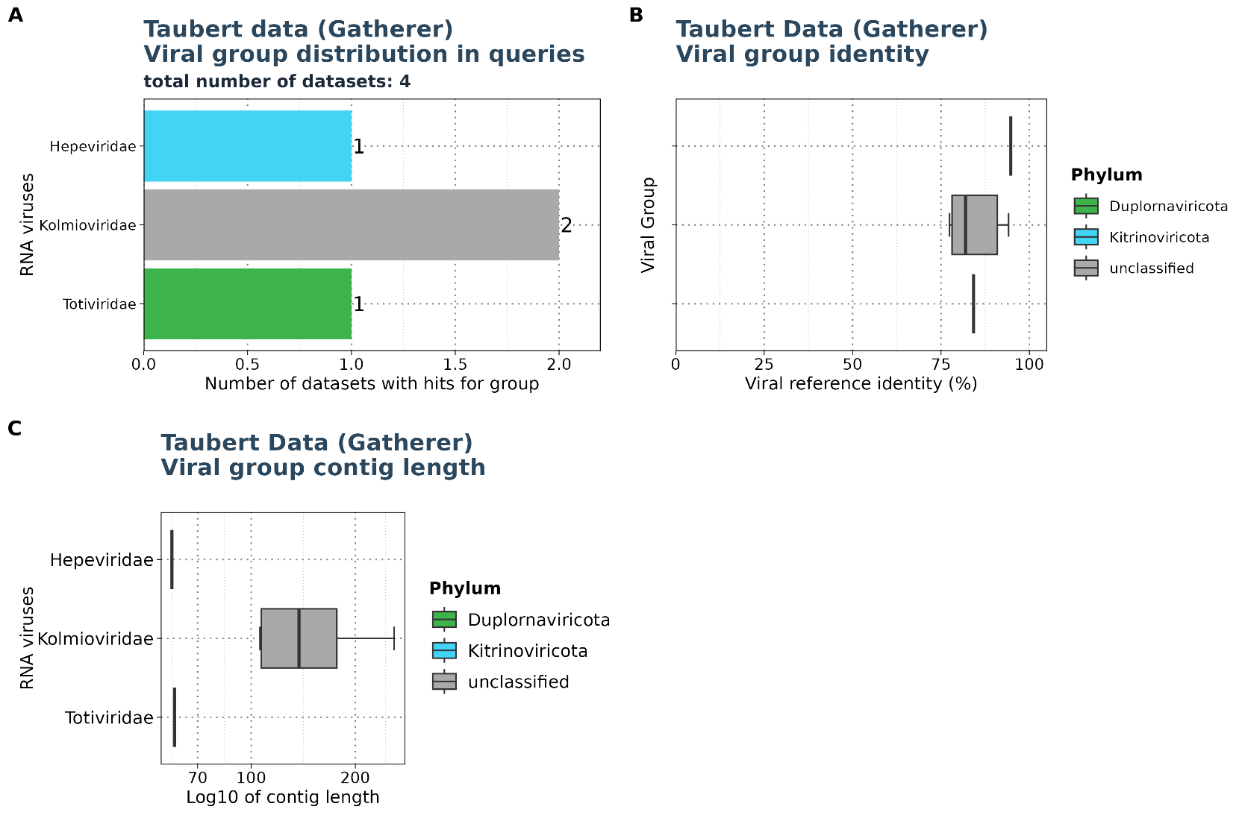
Results: Taubert
RNA viruses

Slide 12
Results: Mammal

Slide 13
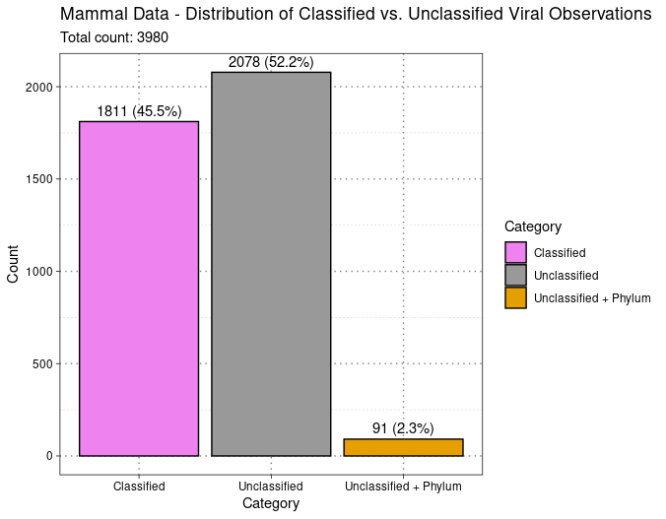
Results: Mammal
Classified vs unclassified
Existing Hittable
Viral Family extracted from
ViralRefSeq_taxonomy column
- Existing Hittable after filtering: 3980 observations for 1666 unique SRA IDs.

Slide 14
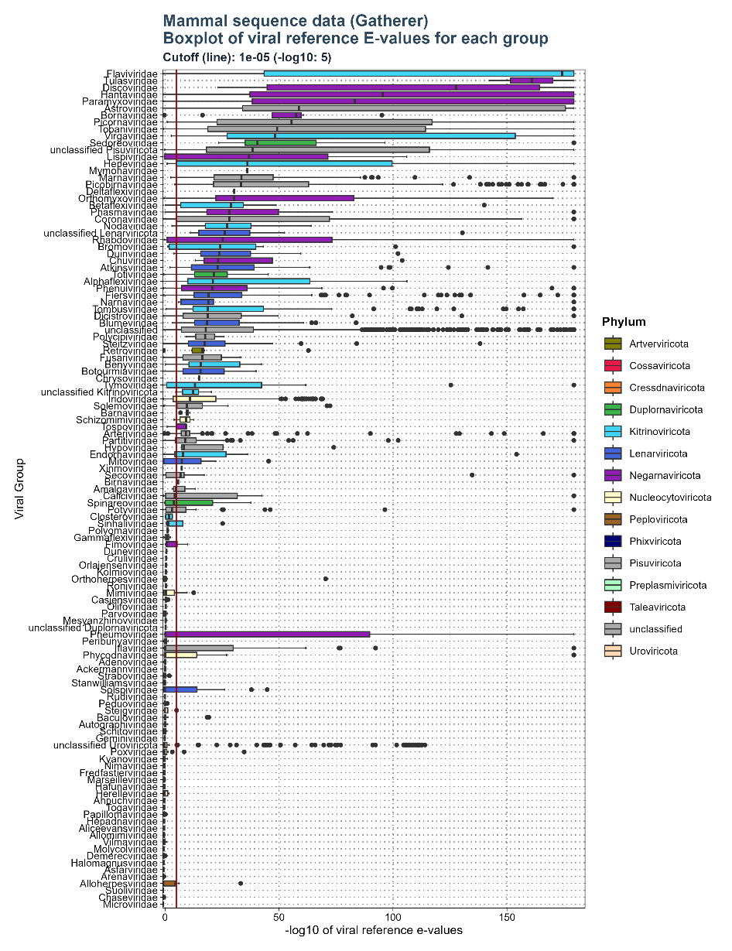
Results: Mammal – E-values
Viral reference E-values for
each viral groups
Cutoff: 1e-5

Slide 15
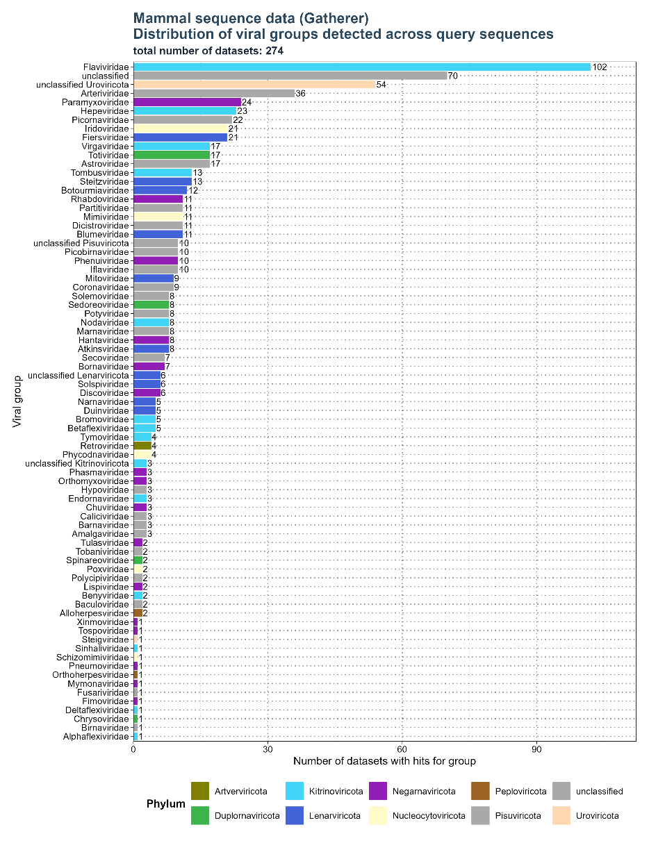
Results: Mammal
Distribution of groups across queries
Filtered for significant observations (E-value < 1e-5)

Slide 16
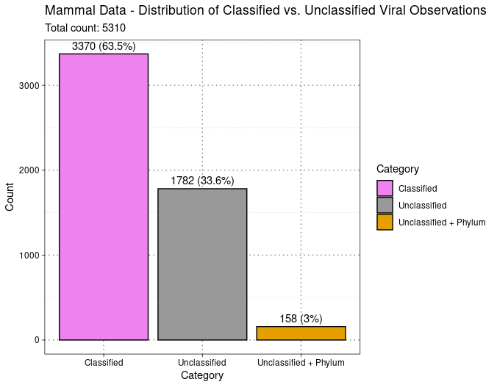
Results: Mammal
classified vs unclassified
Viral Family extracted from
ViralRefSeq_taxonomy column
- 5310 observations for 274 unique SRA IDs.

Slide 17
Results: Mammal

